Slide 1



AFTER POPCORN
Study of movie and show public reception in various platforms.
David Moreno Esteban
Emma Fraxanet Morales

Slide 2
Overview
Introduction
Data gathering – Twitter API
Topic modelling
Sentiment analysis: Wandavision
Data gathering - Youtube, Reddit, Imdb
Sentiment analysis: Movies
Data gathering – Wikipedia
Pageview correlations
Summary & conclusions

Slide 3
INTRODUCTION

Slide 4
DATA GATHERING - Twitter API
Introduction
Topic modelling
Sentiment analysis
Pageviews
Conclusions
Twitter API
python tweepy Cursor
Search old tweets in case we missed on a specific topic.
Twitter API
python tweepy StreamListener
Tweets about a specific topic:
Wandavision
keywords = ["wandavision","WandaVision"]
Premiere
keywords = ['movie premiere','new movie','new episode', 'new film']

Slide 5

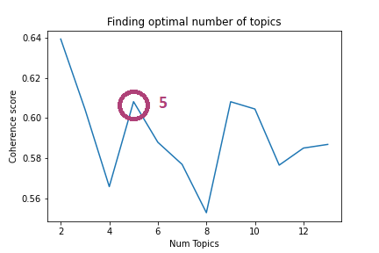
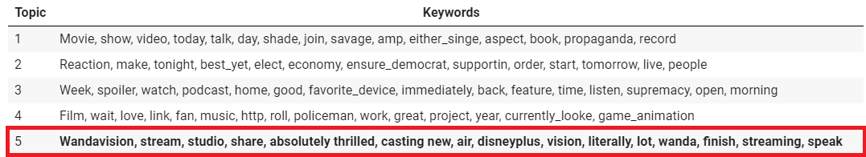
5 February
Introduction
Topic modelling
Sentiment analysis
Pageviews
Conclusions
Optimal number of topics
Well defined Wandavision topic

Slide 6
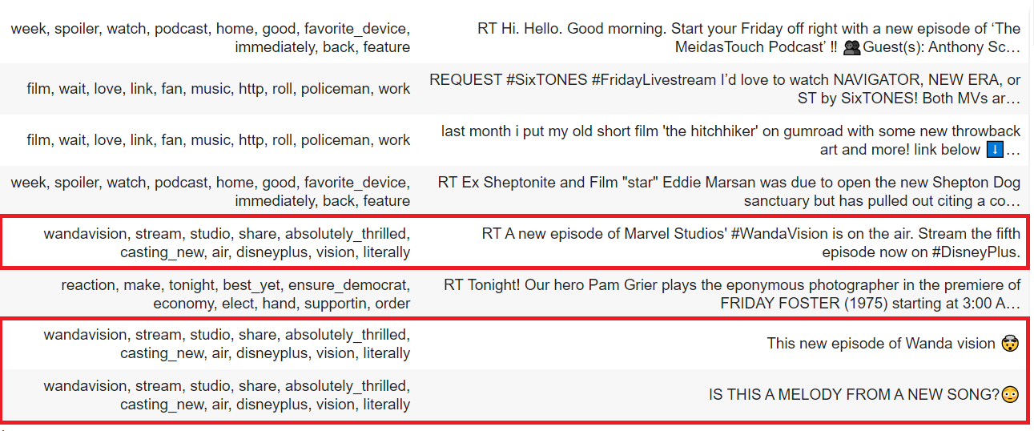
Example tweets
Introduction
Topic modelling
Sentiment analysis
Pageviews
Conclusions
Example tweets

Slide 7
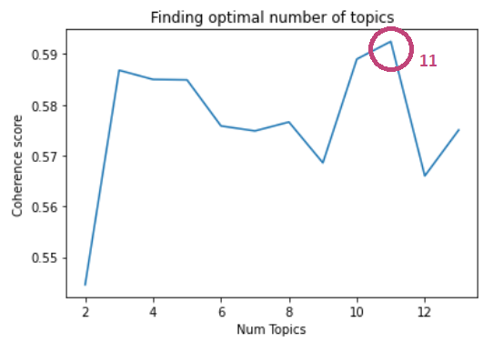
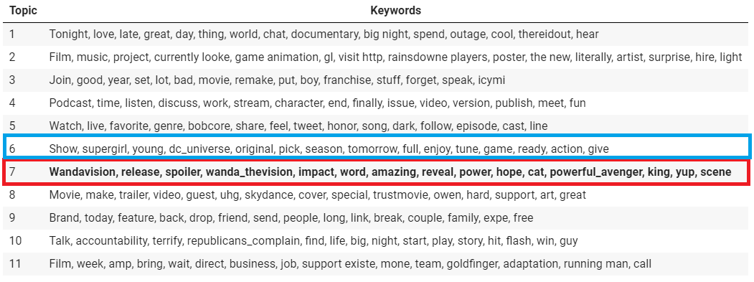
19 February
Introduction
Topic modelling
Sentiment analysis
Pageviews
Conclusions

Slide 8
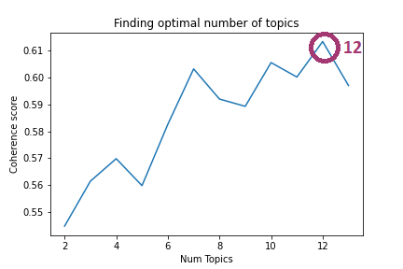
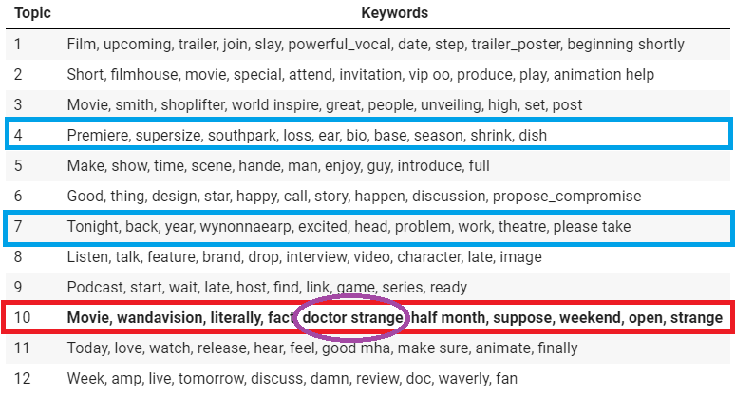
5 March
Introduction
Topic modelling
Sentiment analysis
Pageviews
Conclusions

Slide 9
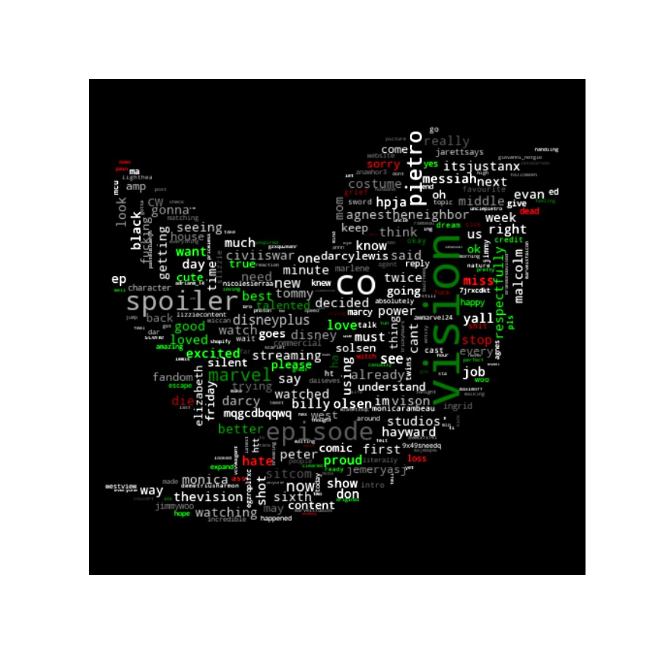
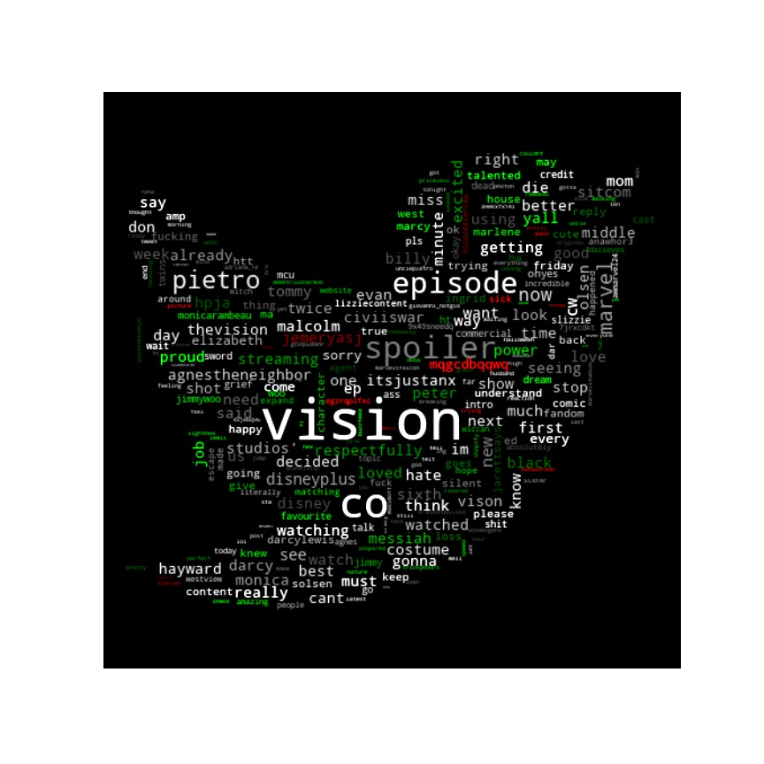
Sentiment analysis: WandaVision
Introduction
Topic modelling
Sentiment analysis
Pageviews
Conclusions

Slide 10
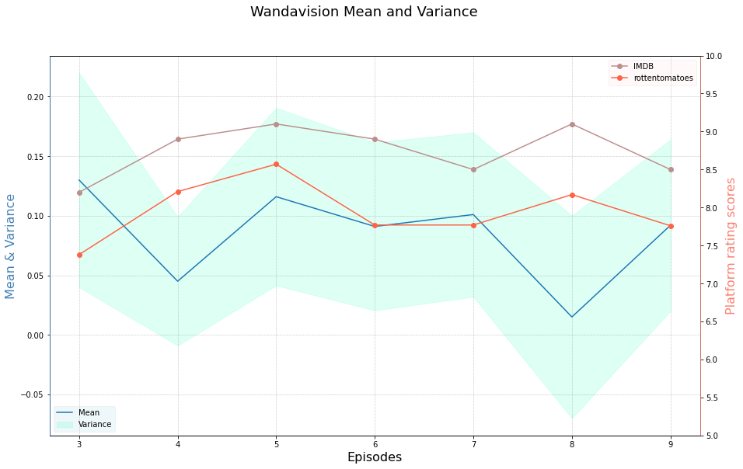
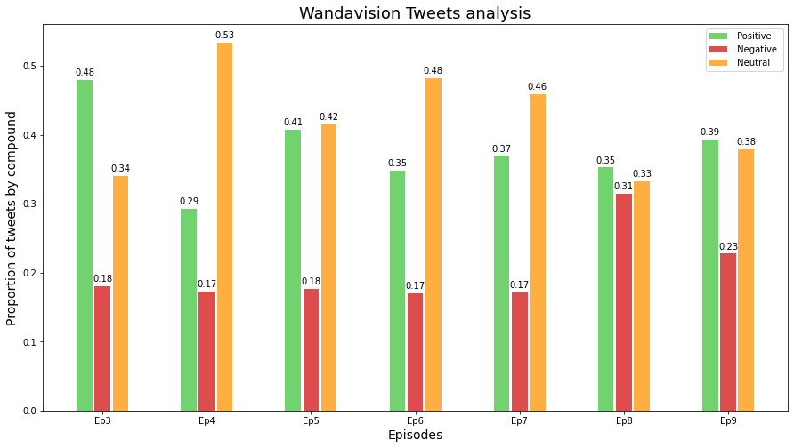
Season evolution
Introduction
Topic modelling
Sentiment analysis
Pageviews
Conclusions

Slide 11
Data gathering
Introduction
Topic modelling
Sentiment analysis
Pageviews
Conclusions
Youtube API
python youtube-data-api
Comments of particular film videos from well known reviewers of the platform
Reddit API
python praw
Comments from official post regarding the film review
IMDB
python beautifulsoup
Scraping and crawling the IMDB webpage

Slide 12
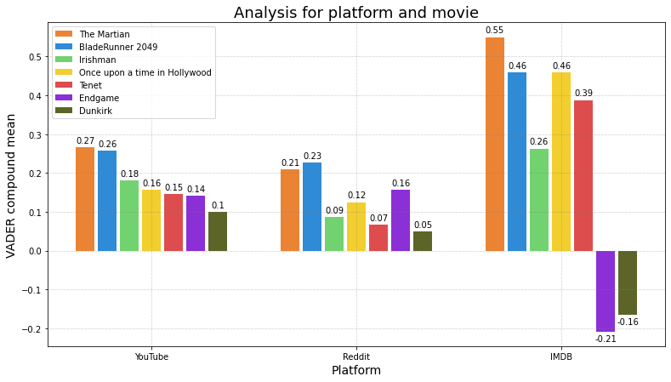



Sentiment analysis: Movies
Introduction
Topic modelling
Sentiment analysis
Pageviews
Conclusions
Youtube and Reddit have similar results
IMDB is more polarized
But!... Endgame and Dunkirk films contain negative words intrinsically

Slide 13
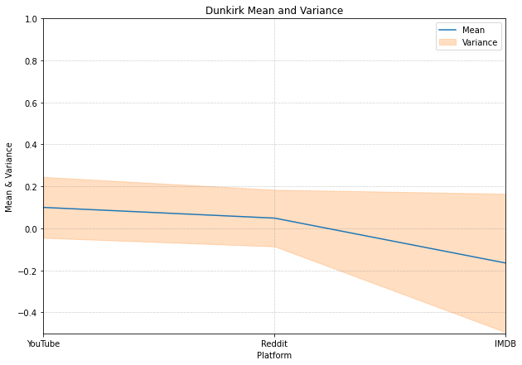

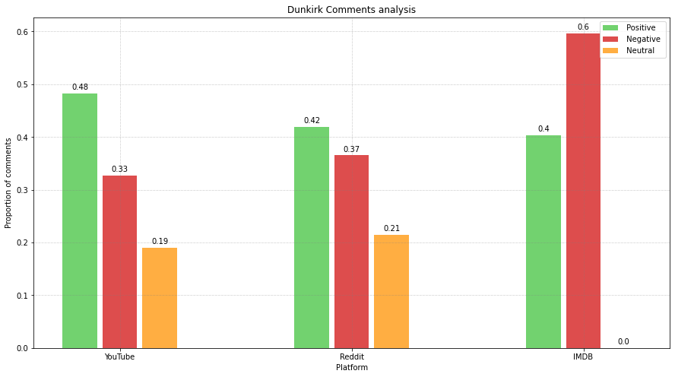
Dunkirk (2017) individual results
Introduction
Topic modelling
Sentiment analysis
Pageviews
Conclusions
Larger variance!

Slide 14
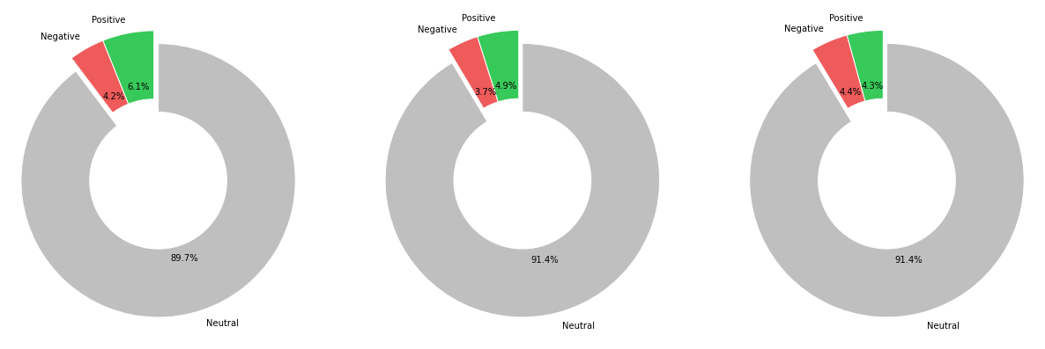
Mean positive/negative/neutral words per comment
Introduction
Topic modelling
Sentiment analysis
Pageviews
Conclusions

Slide 15
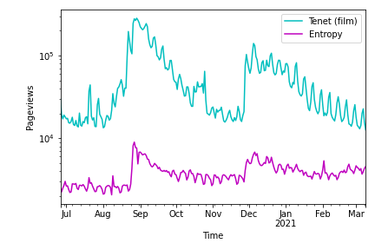
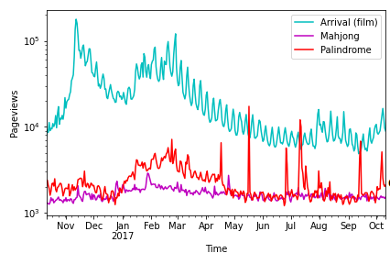



Introduction
Topic modelling
Sentiment analysis
Pageviews
Conclusions
PAGEVIEWS CORRELATION
.VS. ENTROPY
PALINDROME .VS.
Pearson correlation
0.73
0.36

Slide 16
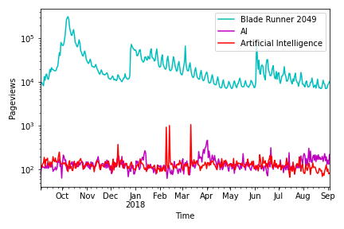
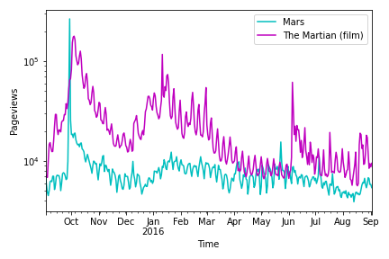




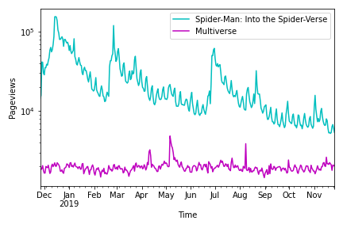
Introduction
Topic modelling
Sentiment analysis
Pageviews
Conclusions
AI MARS MULTIVERSE

Slide 17

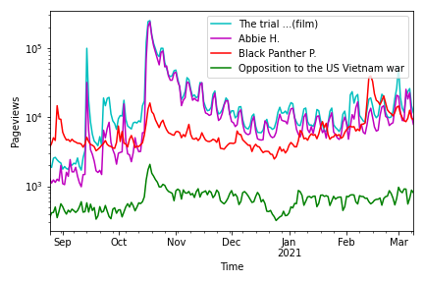
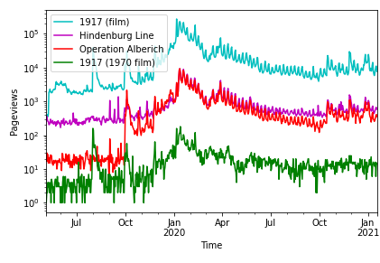


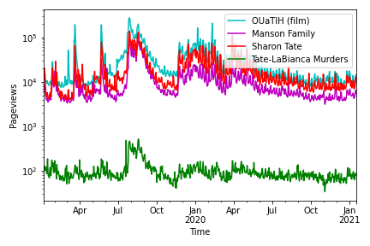
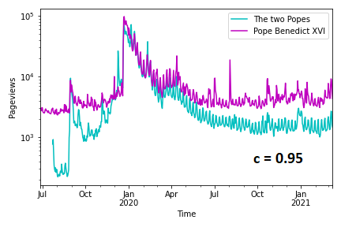

Introduction
Topic modelling
Sentiment analysis
Pageviews
Conclusions

Slide 18
SUMMARY AND CONCLUSIONS

